Slide 1
LINQ to Objects
Ronnie Holm
Lecture 6

Slide 2
Agenda
Introduction to LINQ
Implicitly typed local variables
Object/collection initialization syntax
Lambda expressions
Extension methods
Adding all the pieces together

Slide 3
Introduction to LINQ
LINQ is a strongly-typed symmetric query language
Enables querying any collection implementing IEnumerable<T>
IEnumerable<T> denotes a sequence of elements
Array
List
Xml DOM
Tables in database
Notes:
- Query operator is a method that transforms a sequence - Typical query operator accepts an input sequence and emits a transformed output sequence - IEnumerable in System.Linq contains around 40 standard query operators implemented as static extension methods - Queries that operate on local sequences are called local queries or LINQ to object queries - LINQ also supports sequences originating from a remote data source - These sequences additionally implement IQueryable<T> - Queryable class has a matching set of query operators

Slide 4
Introduction to LINQ (2)
class Program {
static void Main(string[] args) {
string[] games = {
"Morrowind", "Uncharted 2",
"Fallout 3", "Daxter",
"System Shock 2" };
string[] gamesWithSpaces =
new string[games.Length];
for (int i = 0; i < games.Length; i++) {
if (games[i].Contains(" ")) {
gamesWithSpaces[i] = games[i];
}
}
Array.Sort(gamesWithSpaces);
foreach (string s in gamesWithSpaces) {
if (s != null) {
Console.WriteLine(s);
}
}
}
}
class Program {
static void Main(string[] args) {
string[] games = {
"Morrowind", "Uncharted 2",
"Fallout 3", "Daxter",
"System Shock 2" };
IEnumerable<string> subset =
from g in games
where g.Contains(" ")
orderby g
select g;
foreach (string s in subset) {
Console.WriteLine(s);
}
}
}
Notes:
- Left: imperative - Right: functional

Slide 5
Implicitly typed local variables
Allows for the definition of local variables without specifying their type
With LINQ, the return type quickly becomes very complicated and sometimes impossible to express without the var keyword
class Program {
static void Main(string[] args) {
var myInt = 0;
var myBool = true;
var myString = "some string";
}
}

Slide 6
Implicitly typed local variables (2)
class Program {
static void Main(string[] args) {
int[] numbers = { 10, 20, 30, 40, 1, 2, 3, 8 };
// generally use var as the type of LINQ queries as the
// exact type is rarely important
IEnumerable<int> subset1 =
from i in numbers
where i < 10
select i;
// System.Linq.Enumerable+WhereArrayIterator`1[System.Int32]
Console.WriteLine(subset1.GetType());
IEnumerable<int> subset2 =
from i in numbers
where i < 10
orderby i
select i;
// System.Linq.OrderedEnumerable`2[System.Int32,System.Int32]
Console.WriteLine(subset2.GetType());
}
}

Slide 7
Object/collection initialization syntax
Object syntax allows you to create a instance of a type and set any number of public properties at the same time
Collection syntax allows you to initialize a collection upon creation
class Program {
static void Main(string[] args) {
List<Rectangle> myListOfRects = new List<Rectangle> {
new Rectangle { TopLeft = new Point { X = 10, Y = 10 },
BottomRight = new Point { X = 200, Y = 200 }},
new Rectangle { TopLeft = new Point { X = 2, Y = 2 },
BottomRight = new Point { X = 100, Y = 100 }}
};
}
}

Slide 8
Object/collection initialization syntax (2)
class Order {
public int OrderNumber { get; set; }
public string Recipient { get; set; }
public decimal Amount { get; set; }
}
class Person {
public string Firstname { get; set; }
public string Lastname { get; set; }
}
class Program {
static void Main(string[] args) {
List<Order> orders = new List<Order> {
new Order { OrderNumber = 1,
Recipient = "John Doe",
Amount = 19.99m },
new Order { OrderNumber = 2,
Recipient = "Jane Doe",
Amount = 29.99m }
};
var people =
from o in orders
where o.Amount > 25m
select new Person {
Firstname = o.Recipient.Split(' ')[0],
Lastname = o.Recipient.Split(' ')[1],
};
foreach (Person p in people) {
Console.WriteLine(
p.Firstname + " " + p.Lastname);
}
}
}
Projection using
object initialization syntax

Slide 9
Lambda expressions
Greatly simplifies how you work with delegates
Query operators are shorthand notation for calling methods on System.Linq.Enumerable
These methods typically require delegates as parameters
class Program {
static void Main(string[] args) {
List<int> list = { 20, 1, 4, 8, 9, 44 };
// delegate bool Predicate(int)
// compatible with Func<int, bool> delegate // List<int> List<int>.FindAll(Predicate<int> match)
// (ArgumentsToProcess) => { StatementsToProcessThem }
List<int> even = list.FindAll(i => (i % 2) == 0);
}
}

Slide 10
Lambda expressions (2)
class Program {
static void Main(string[] args) {
string[] games = {
"Morrowind", "Uncharted 2",
"Fallout 3", "Daxter",
"System Shock 2" };
IEnumerable<string> subset =
from g in games
where g.Contains(" ")
orderby g
select g;
foreach (string s in subset) {
Console.WriteLine(s);
}
}
}
class Program {
static void Main(string[] args) {
string[] games = {
"Morrowind", "Uncharted 2",
"Fallout 3", "Daxter",
"System Shock 2" };
IEnumerable<string> subset = games
.Where(g => g.Contains(" "))
.OrderBy(g => g)
.Select(g => g);
foreach (string s in subset) {
Console.WriteLine(s);
}
}
}
var gamesWithSpaces = games.Where(g => g.Contains(" "));
var orderedGames = gamesWithSpaces.OrderBy(g => g);
var subset = orderedGames.Select(g => g);
Notes:
- Query expression syntax vs. method invocation syntax

Slide 11
Extension methods
Allows adding methods to any class without modifying its source code or sub-classing it
Extension methods get added through the using statement
public static class StringExtensions {
public static string ConvertWhitespacesToSingleSpaces(this string value) {
return value = Regex.Replace(value, @"\s+", " ");
}
}
class Program {
static void Main(string[] args) {
string s = "test !";
Console.WriteLine(StringExtensions.ConvertWhitespacesToSingleSpaces(s));
Console.WriteLine(s.ConvertWhitespacesToSingleSpaces());
}
}

Slide 12
Extension methods (2)
public static class EnumerableExtensions {
public static IEnumerable<TSource> MyWhere<TSource>(
this IEnumerable<TSource> source,
Func<TSource, bool> predicate) {
foreach (TSource element in source) {
if (predicate(element))
yield return element;
}
}
public static IEnumerable<TResult> MySelect<TSource, TResult>(
this IEnumerable<TSource> source,
Func<TSource, TResult> selector) {
foreach (TSource element in source)
yield return selector(element);
}
}
class Program {
static void Main(string[] args) {
List<Person> people = new List<Person> {
new Person { Name = "John Doe" },
new Person { Name = "Jane Doe" }
};
var subset = people
.MyWhere(p => p.Name.StartsWith("Jo"))
.MySelect(p => p.Name);
foreach (var p in subset) {
Console.WriteLine(p);
}
}
}

Slide 13
Extension methods (3)
Extension methods provide the syntactic sugar to make chaining methods on a collection feel like chaining on an object of your own
var subset = people
.MyWhere(p => p.Name.StartsWith("Jo"))
.MySelect(p => p.Name);
var subset =
EnumerableExtensions.MySelect(
EnumerableExtensions.MyWhere(people, p => p.Name.StartsWith("Jo")),
p => p.Name);

Slide 14
Anonymous types
Allows the compiler to generate a new class to model the shape of data based on the supplied set of key/value pairs
class Program {
static void Main(string[] args) {
var person = new {
Firstname = "John",
Lastname = "Doe"
};
// <>f__AnonymousType0`2[System.String,System.String]
Console.WriteLine(person.GetType());
// John doe
Console.WriteLine(person.Firstname + " " + person.Lastname);
}
}

Slide 15
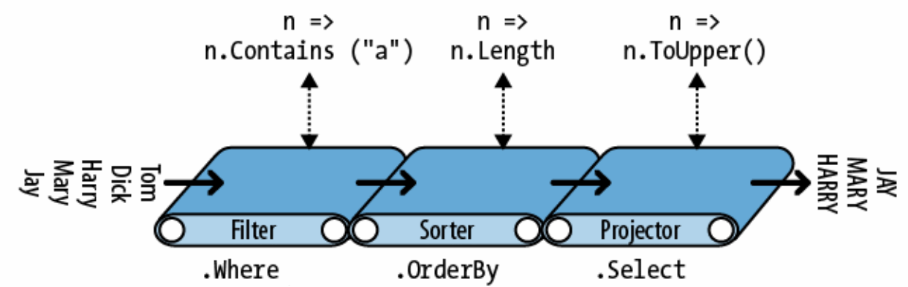
Chaining query operators
class Program {
static void Main(string[] args) {
string[] names = {
"Tom", "Dick", "Harry",
"Mary", "Jay" };
IEnumerable<string> query = names
.Where(n => n.Contains("a"))
.OrderBy(n => n.Length)
.Select(n => n.ToUpper());
foreach (string name in query) {
Console.WriteLine(name);
}
}
}
class Program {
static void Main(string[] args) {
string[] names = {
"Tom", "Dick", "Harry",
"Mary", "Jay" };
// same query constructed progressively
// Harry, Mary, Jay
IEnumerable<string> filtered =
names.Where(n => n.Contains("a"));
// Jay, Mary, Harry
IEnumerable<string> sorted =
filtered.OrderBy(n => n.Length);
// JAY, MARY, HARRY
IEnumerable<string> finalQuery =
sorted.Select(n => n.ToUpper());
}
}

Slide 16
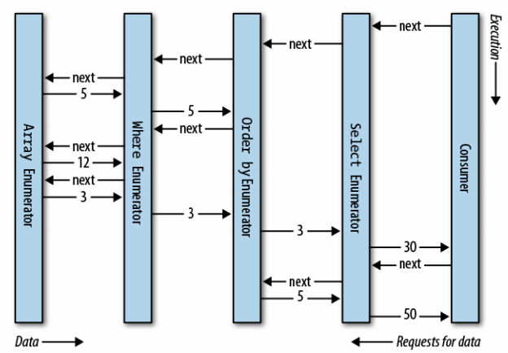
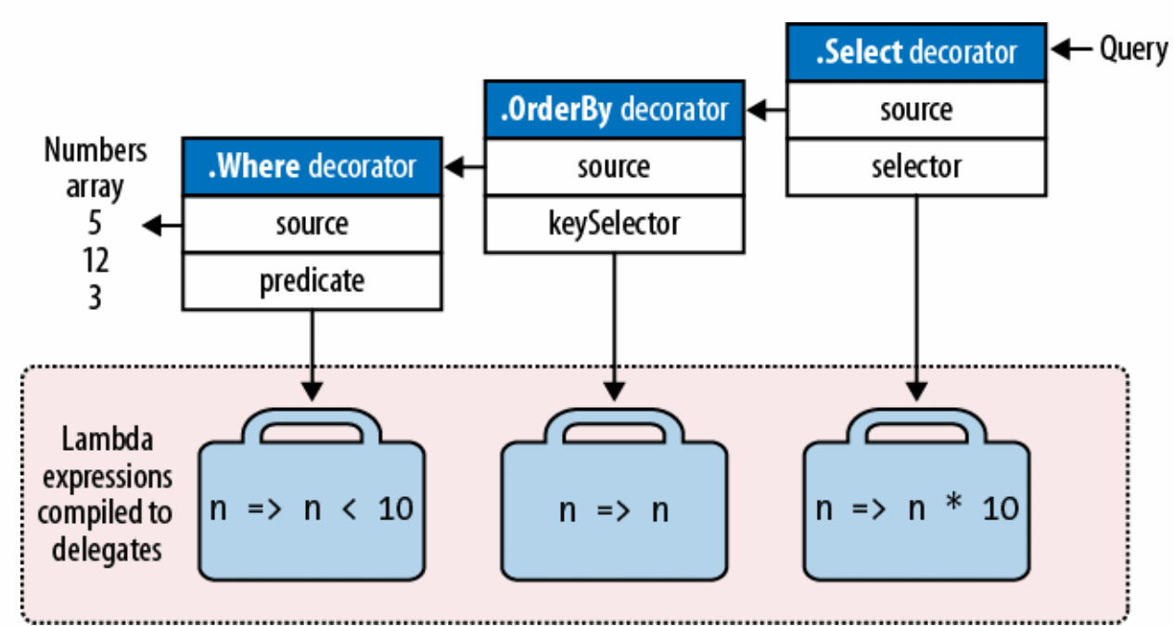
Chaining query operators (2)
class Program {
static void Main(string[] args) {
IEnumerable<int> query = new[] {
5, 12, 3 }
.Where(n => n < 10)
.OrderBy(n => n)
.Select(n => n * 10);
foreach (var item in query) {
Console.WriteLine(item);
}
}
}
Notes:
- Note how the query executes lazily

Slide 17
Additional resources
http://code.msdn.microsoft.com/101-LINQ-Samples-3fb9811b
http://www.bugfree.dk/blog/2010/10/19/demystifying-linq-to-objects/

